Slide 1
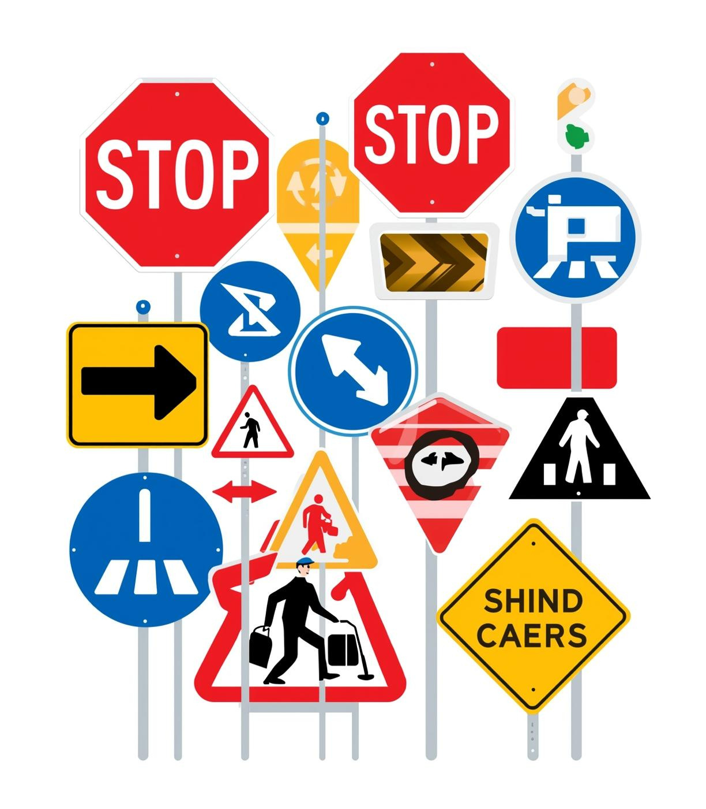
Traffic Sign Recognition Based on HOG Feature and SVM
AUTHORS: JIALIN TANG, QINGLANG SU, CHENYU LIN*, YANGJUN WEN, BINGHUA SU, JUQING YANG
VENUE: EITCE '20: PROCEEDINGS OF THE 2020 4TH INTERNATIONAL CONFERENCE ON ELECTRONIC INFORMATION TECHNOLOGY AND COMPUTER ENGINEERING
Presented by:-
Tejas Deshmukh (230150027)
Aryan Gupta (230150003)

Slide 2
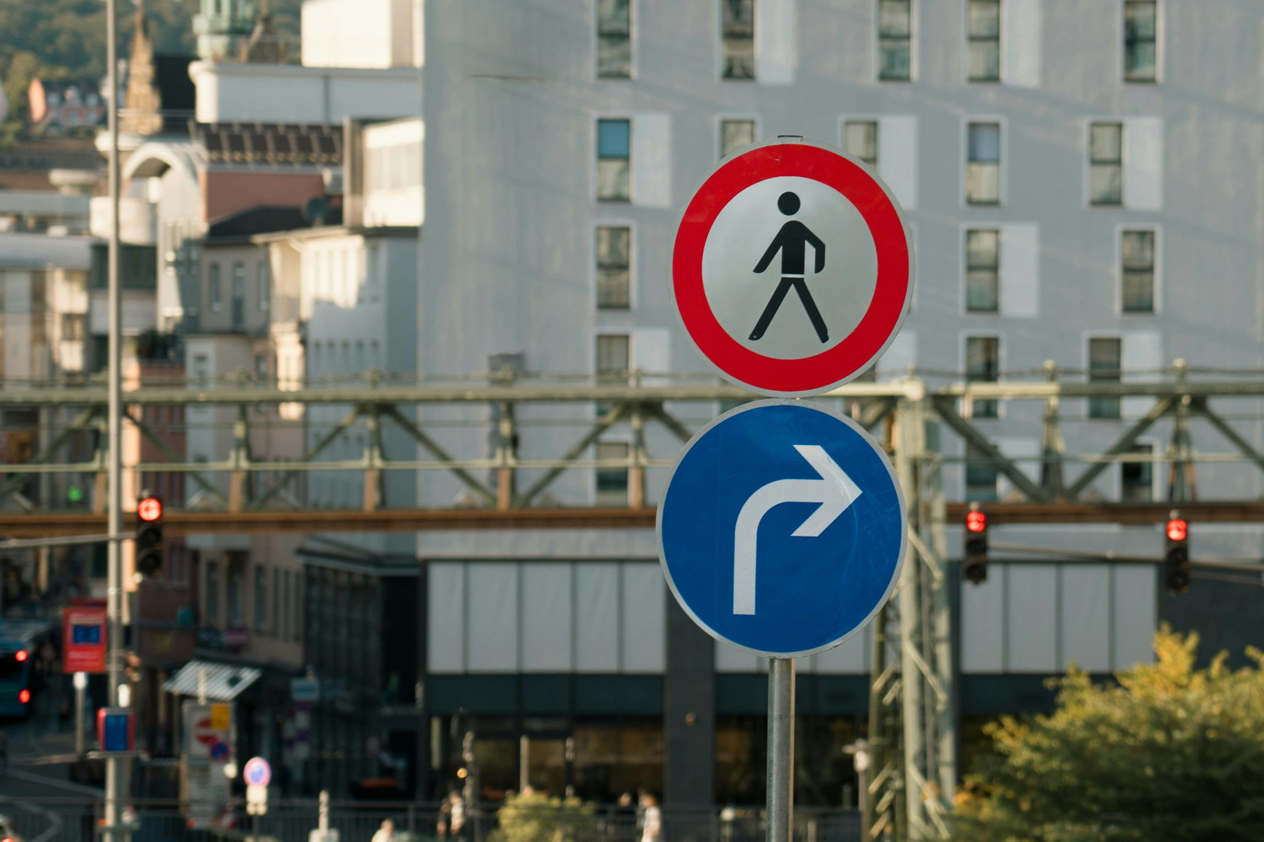
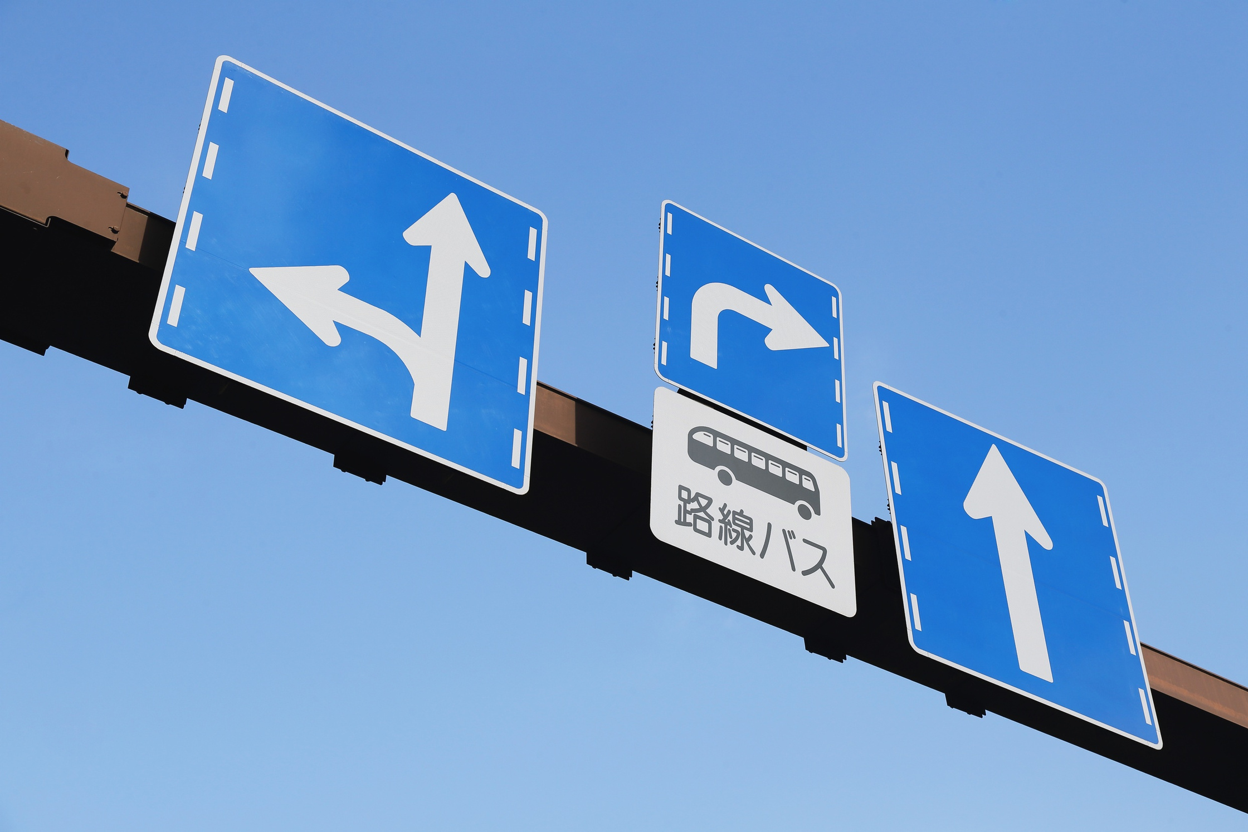
Introduction
Problem: Reliable identification of road traffic signs
Relevant applications
Autonomous Driving
Street-View Integration
Image-based traffic sign recognition is essential for safe and reliable assisted driving and autonomous driving vehicles.
Detecting signs from images lets us integrate them into map/street-view platforms (e.g., Google Maps) to improve navigation and situational awareness.

Slide 3
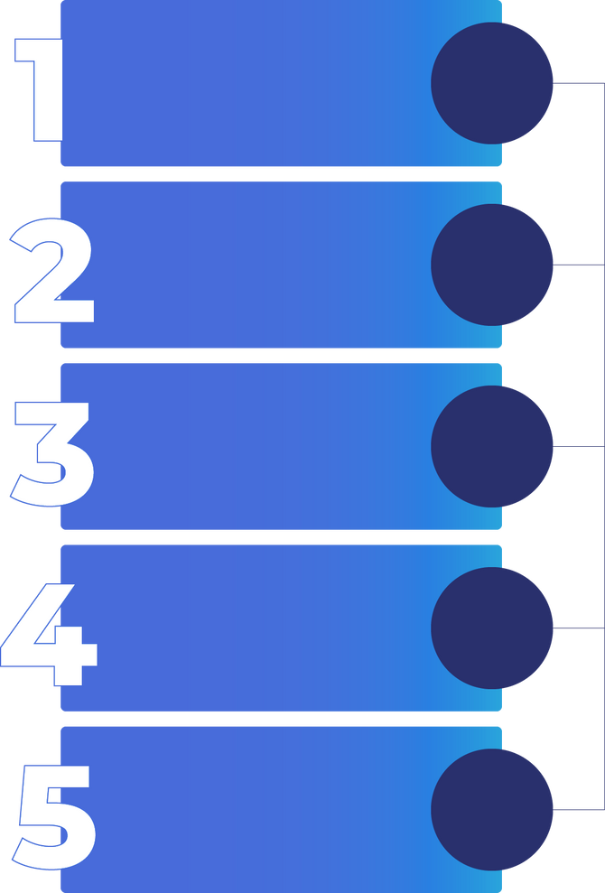
Introduction - Pipeline Flow
Image enhancement
Boost contrast and normalize lighting (RGB→YUV + adaptive histogram equalization) for clearer sign appearance.
Color segmentation
Convert to HSV and threshold hue ranges to isolate red/blue/yellow candidate regions.
Sign localization
Find sign candidates with Hough circle detection and contour/polygon analysis (tri/quad detection).
HOG Feature extraction
Compute gradient-orientation histograms on normalized patches (e.g., 64×64, 8×8 cells) to form robust descriptors.
Train an SVM to classify HOG vectors into traffic-sign categories.
SVM classification

Slide 4
Prior Work
Extensive research has been conducted on traffic sign detection using Deep Convolutional Neural Networks (CNNs) and Support Vector Machines (SVMs).
Greenhalgh et al. (2012) — German Traffic Sign Detection
Proposed a two-step method:
1
MSER (Maximally Stable Extremal Regions)
2
SVM Classifier with HOG Features
Extracted candidate areas of traffic signs by identifying stable regions in varying illumination and contrast.
Trained on features extracted from these candidate regions for precise classification.
This approach achieved high accuracy on the GTSRB (German Traffic Sign Recognition Benchmark) dataset, proving the effectiveness of combining MSER + HOG + SVM.

Slide 5
Prior Work
Rise of Deep Learning
With the rise of Deep Learning, researchers adopted Deep Neural Networks (DNNs) for end-to-end recognition.
DNN-based models automatically learn both feature extraction and classification, eliminating manual feature design.
Deep CNN Architectures
German scientists trained deep CNN architectures for traffic sign recognition, achieving:
Accuracy surpassing average human recognition levels.
Improved robustness under lighting, rotation, and occlusion conditions.
These advancements laid the foundation for modern intelligent driving systems.

Slide 6
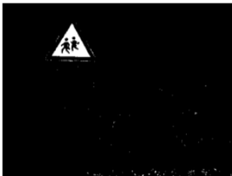
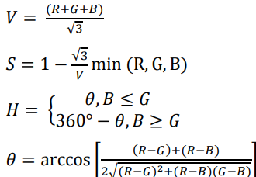
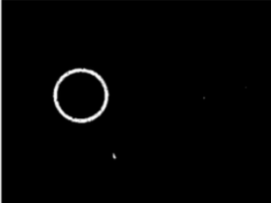
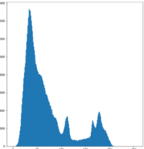
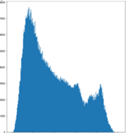
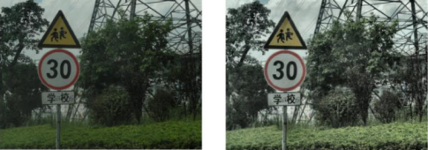
But what is different?
The difference lies in the pre-computation part of the pipeline.
01
02
IMAGE ENHANCEMENT
COLOR SEGMENTATION
Transform camera image to YUV using equations below and then applying adaptive histogram equalisation:
Transform into HSV values and segment based on the commonly used colours in traffic signs(red, yellow, blue).
Y = 0.299R + 0.587G + 0.114B
U = −0.147R − 0.289G + 0.436B
V = 0.615R − 0.515G − 0.100B
03
SIGN LOCALISATION
Circle detection: Use the Hough transform to map edge points into parameter space and detect circles robustly
Triangle/rectangle detection: Extract contours from the binary image, apply polygonal fitting to remove noise, then classify shapes by vertex count (3 → triangle, 4 → rectangle).

Slide 7
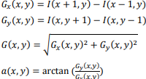

HOG Extraction
HOG is a feature descriptor commonly used for target detection in computer vision and image processing. It can well represent the outline and edge information of traffic signs.
The gradient of the traffic sign image in the horizontal and vertical directions of the pixel points (𝑥, 𝑦) is:-
Divide the image into several cells
Collect the gradient direction histogram of each pixel point in each cell
Cells are blocked and normalized
Feature vectors in all the blocks are concatenated
Horizontal and Vertical Gradients
Magitude
Direction
N = Dimension of HOG feature space
Iw and Ih = dimensions of image
Cw and Ch = dimensions of cell
B = number of cell in each block

Slide 8
SVM Training, Evaluation & Conclusion
SVM Formulation
Validation & Results
Map HOG descriptors to a high-dimensional space via kernel methods; training minimises ||ω||²/2 + C∑εᵢ to obtain maximum-margin hyperplane.
Evaluate on the test set and additional sample subsets — model demonstrates robustness under varying illumination and partial occlusion; failure modes include very small targets, severe reflections, and strong motion blur.
Hyperparameters & Kernel
Select penalty C (from 1 to 200) and kernel (Linear, Polynomial, RBF, Sigmoid) to produce optimal trade-off between margin and misclassification.
Conclusion
HOG + SVM provides a computationally efficient and accurate baseline for traffic sign recognition; remaining challenges motivate future work on small-object detection and blur/reflection mitigation.

Slide 9
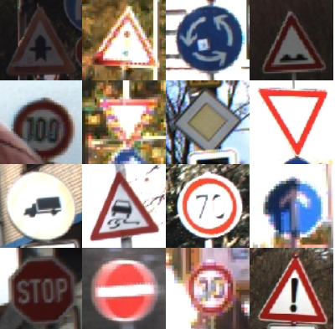
GTSRB — German Traffic Sign Recognition Benchmark
Overview
1
Real-world traffic-sign dataset for classification and detection.
Scale & Classes
2
≈ 50k images, 43 classes (multi-condition imaging).
Image & Format
3
PPM images, variable sizes (~15×15 to 250×250); each image contains one sign.
Annotations
4
CSV files per class with image size, bounding-box (ROI) coordinates and ClassId.

Slide 10
What We Will Demonstrate.
Preprocessing & Enhancement: Implement RGB→YUV conversion and adaptive histogram equalisation on the Y channel to correct blur/brightness.
Colour Segmentation: HSV/H-based thresholding to extract red/blue/yellow candidate regions.
Localisation & Shape Analysis(Using OpenCV Python Library): Detect circular signs via Hough transform and polygonal signs via contour + polygon approximation.
Feature Extraction: Compute HOG descriptors on resized sign patches (64×64) to form feature vectors for classification.
Classifier Implementation: Train an SVM on a subset of the GTSRB dataset, but produce the final model using the scikit-learn Python library using the whole dataset.
Evaluation & Analysis: Report accuracy, per-class recall/precision and confusion matrix using scikit-learn Python library.

Slide 11

What We Will Demonstrate (End-of-Semester)
1. Preprocessing & Enhancement: Implement RGB→YUV conversion and adaptive histogram equalization on the Y channel to correct blur/brightness.
2. Colour Segmentation: HSV/H-based thresholding to extract red/blue/yellow candidate regions.
3. Localisation & Shape Analysis(Using OpenCV Python Library): Detect circular signs via Hough transform and polygonal signs via contour + polygon approximation.
4. Feature Extraction: Compute HOG descriptors on resized sign patches (64×64) to form feature vectors for classification.
5. Classifier Implementation: Train an SVM (RBF kernel, tuned penalty C) on GTSRB and produce the final model.
6. Evaluation & Analysis: Report accuracy, per-class recall/precision, confusion matrix, and document failure modes (small targets, reflections, motion blur).
Notes:
10

Slide 12

Elaborate on
what you want
to discuss.
Elaborate on
what you want
to discuss.
Elaborate on
what you want
to discuss.
Elaborate on
what you want
to discuss.
Elaborate on
what you want
to discuss.

Slide 13
GTSRB — German Traffic Sign Recognition Benchmark
Overview
1
Real-world traffic-sign dataset for classification and detection.
Scale & Classes
2
≈ 50k images, 43 classes (multi-condition imaging).
Image & Format
3
PPM images, variable sizes (~15×15 to 250×250); each image contains one sign.
Annotations
4
CSV files per class with image size, bounding-box (ROI) coordinates and ClassId.
Use
5
Widely used for benchmarking TSR algorithms.
Notes:
9

Slide 14
Traffic signs are essential tools for ensuring road safety. They convey crucial information to drivers and pedestrians, including regulations, warnings, and guidance. Familiarity with these signs helps prevent accidents and promotes a smoother flow of traffic in urban and rural settings alike.
Understanding Traffic Signs
There are various types of traffic signs, each serving a unique purpose. Recognizing these signs can enhance safety and improve navigation on roadways, making them fundamental components of road systems worldwide.

Slide 15
Informational Signs: Your Guide to Safety
Directional Indicators
Distance Markers
Service Signage
Directional signs help drivers locate key destinations, ensuring safe navigation and enhancing travel efficiency throughout various routes and roads.
Distance signs provide crucial information about how far you are from your destination, keeping travelers informed and allowing them to plan their journeys effectively.
Service signs indicate amenities like gas stations, restaurants, and rest areas, promoting driver comfort and ensuring that essential services are easily accessible during travel.

Slide 16
Understanding Regulatory Traffic Signs
Importance of Compliance
Types of Regulatory Signs
Consequences of Ignoring Signs
Regulatory signs inform drivers of essential laws and regulations, ensuring safety on the road and promoting orderly traffic flow.
Common regulatory signs include stop signs, yield signs, and speed limit signs, each serving a crucial role in guiding driver behavior.
Failure to obey regulatory signs can result in fines, accidents, and increased risk for all road users, emphasizing the need for attentiveness.

Slide 17

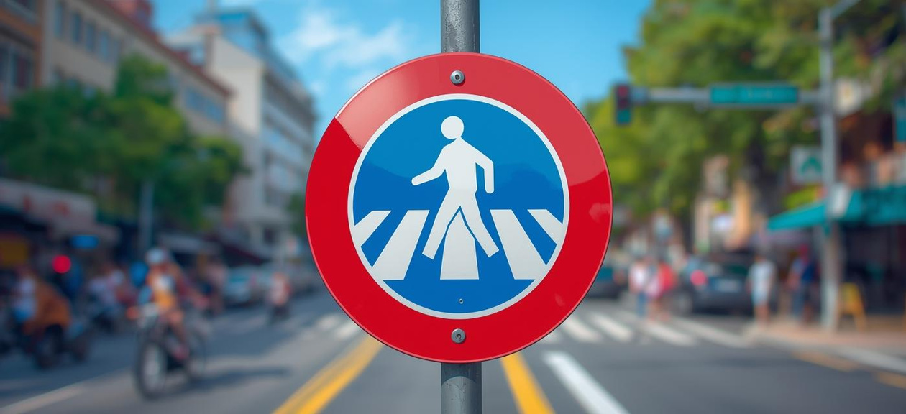
Warning Signs
Stay Aware of Your Surroundings

Slide 18

Contact Us
For more information and resources about traffic signs
EMAIL
hello@reallygreatsite.com
PHONE
123-456-7890
SOCIAL MEDIA
@reallygreatsite

Slide 19
Traffic Sign Recognition Based on HOG Feature and SVM
Authors: Jialin Tang, Qinglang Su, Chenyu Lin*, Yangjun Wen, Binghua Su, Juqing Yang
Venue: EITCE '20: Proceedings of the 2020 4th International Conference on Electronic Information Technology and Computer Engineering
Presented By:
Tejas Deshmukh (230150027)
Aryan Gupta (230150003)
Notes:
1

Slide 20
Introduction
Traffic Sign Recognition in Autonomous Driving
Dataset & Detection
The paper uses the TT100K traffic sign dataset for intelligent detection and recognition of multi-category road signs.
Traffic Sign Recognition (TSR) is a key technology in unmanned driving systems.
Image Enhancement
Applied YUV color space and histogram equalization to fix blurry or low-brightness images.
Sign Localization
Used Hough Transformation to detect traffic sign regions based on spatial features.
Notes:
2

Slide 21
Introduction
Feature Extraction
Classification
Model Validation
Employed HOG (Histogram of Oriented Gradients) for effective local gradient description.
Used SVM (Support Vector Machine) to train and classify traffic signs.
Verified reliability using TT100K test and own sample sets.
Reliable TSR ensures safety, efficiency, and comfort in autonomous and assisted driving.
SVM and HOG remain powerful methods for traffic sign recognition due to strong learning and gradient description abilities.
Notes:
3

Slide 22
Prior Work
Extensive research has been conducted on traffic sign detection using Deep Convolutional Neural Networks (CNNs) and Support Vector Machines (SVMs).
Greenhalgh et al. (2012) — German Traffic Sign Detection
Proposed a two-step method:
1
MSER (Maximally Stable Extremal Regions)
2
SVM Classifier with HOG Features
Extracted candidate areas of traffic signs by identifying stable regions in varying illumination and contrast.
Trained on features extracted from these candidate regions for precise classification.
This approach achieved high accuracy on the GTSRB dataset, proving the effectiveness of combining MSER + HOG + SVM.
Notes:
4

Slide 23
Prior Work
Rise of Deep Learning
With the rise of Deep Learning, researchers adopted Deep Neural Networks (DNNs) for end-to-end recognition.
DNN-based models automatically learn both feature extraction and classification, eliminating manual feature design.
Deep CNN Architectures
German scientists trained deep CNN architectures for traffic sign recognition, achieving:
Accuracy surpassing average human recognition levels.
Improved robustness under lighting, rotation, and occlusion conditions.
These advancements laid the foundation for modern intelligent driving systems.
Notes:
5

Slide 24
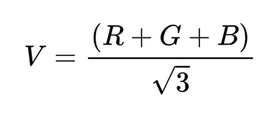
Segmentation & Enhancement
01
02
RGB to YUV Conversion
Y-Channel Enhancement
Transform camera image to YUV using and then applying adaptive histogram equalisation:
Extract Y (luminance) channel and apply adaptive histogram equalization to improve contrast while preserving local details.
Y = 0.299R + 0.587G + 0.114B,
U = −0.147R − 0.289G + 0.436B,
V = 0.615R − 0.515G − 0.100B.
03
04
Reconstruction
Colour Segmentation
Merge equalized Y with U and V, convert back to RGB for subsequent processing.
Normalise RGB, convert to HSV, and threshold the H component to obtain binary masks for red, blue and yellow sign regions.
Notes:
6

Slide 25
Localisation & HOG Extraction
Sign Localisation — Circular Signs
Apply Hough transform on edge maps to detect circular sign candidates in parameter space.
Sign Localisation — Polygonal Signs
Extract contours from binary masks → perform polygon approximation and classify shapes by vertex count (3 → triangle, 4 → rectangle).
Dataset Partitioning
Use TT100K with explicit train/validation/test splits for experimental evaluation.
HOG Feature Computation
Compute gradients Gx,Gy → magnitude and orientation; divide image into 8×8 cells with 4-cell blocks; compute 9-bin histograms; resize sign patches to 64×64 producing HOG descriptors for classification.
Notes:
7

Slide 26
SVM Training, Evaluation & Conclusion
SVM Formulation
Validation & Results
Map HOG descriptors to a high-dimensional space via kernel methods; training minimises ||ω||²/2 + C∑εᵢ to obtain maximum-margin hyperplane.
Evaluate on the test set and additional sample subsets — model demonstrates robustness under varying illumination and partial occlusion; failure modes include very small targets, severe reflections, and strong motion blur.
Hyperparameters & Kernel
Select penalty C (from 1 to 200) and kernel (Linear, Polynomial, RBF, Sigmoid) to produce optimal trade-off between margin and misclassification.
Conclusion
HOG + SVM provides a computationally efficient and accurate baseline for traffic sign recognition; remaining challenges motivate future work on small-object detection and blur/reflection mitigation.
Notes:
8

